Slide 1
Instagram user analytics
Parimi Venkata Surya Kiran

Slide 2
AGENDA
Project Description
Approach
Tech-stack used
Insights
Result

Slide 3
PROJECT DESCRIPTION
To analyze user interactions and engagement with the Instagram app to provide valuable insights that can help the business grow​. User analysis involves tracking how users engage with a digital product, such as a software application or a mobile app. The insights derived from this analysis can be used by various teams within the business.

Slide 4
APPROACH
1. Firstly , I go through the tables that are given the data set.
2. Found the relation between the tables using primary and foreign keys.
3. Understand the task given and choose appropriate tables and columns respectively for the task.
4. Finding the logic for the queries to solve the task.
5. Creating the query according to the logic and checking whether it complete the task.

Slide 5

TECH-STACK USED
SOFTWARE USED : My SQL Workbench 8.0 CE
REASONS TO CHOOSE :
MySQL Workbench is open-source and free to use.
The tool offers query optimization features.
It provides tools for migrating data from other database management systems to MySQL
You can write and execute SQL queries within the application.

Slide 6
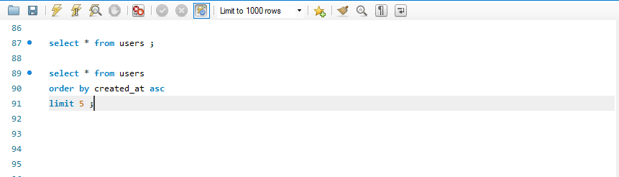
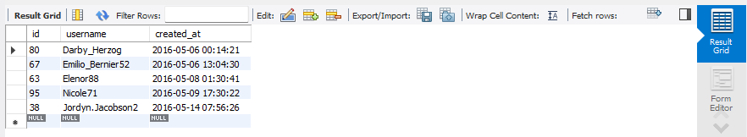
INSIGHTS
Loyal User Reward :
Query input statement
Query Output
This can find the five oldest users in database and with this output , marketing team can reward those users with rewards.

Slide 7
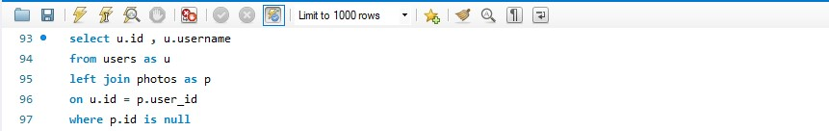
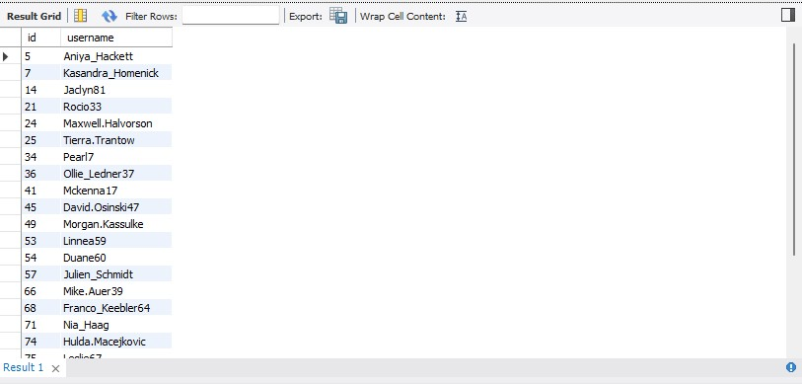
INSIGHTS
Inactive User Engagement :
Query input statement
Query Output
This query statements gives the id and usernames of users who have never posted a single photo on Instagram, With this data team can encourage the list of output users by promotional emails.

Slide 8
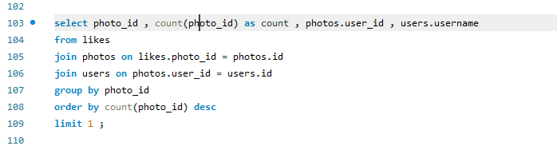
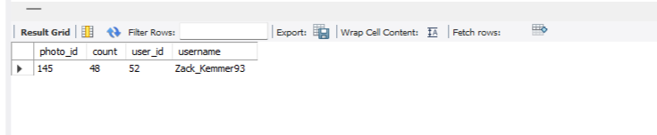
INSIGHTS
Contest Winner Declaration :
Query input statement
Query Output
This query gives the details about the user details who have the more likes on a single photo , here count indicates the number of likes to the photo_id.

Slide 9
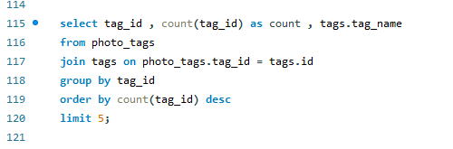
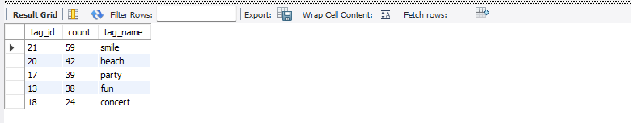
INSIGHTS
Hashtag Research :
Query input statement
Query Output
This query gives top five most commonly used hashtags on platform , with this insights partner brand can use these hashtags on their posts so that it can reach to more people.

Slide 10
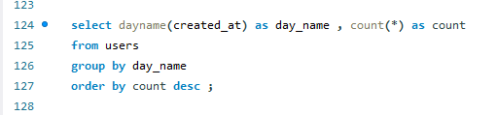
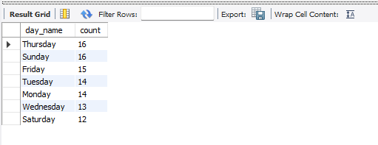
INSIGHTS
Ad Campaign Launch :
Query input statement
Query Output
This query gives day of the week when most users register on Instagram. Thursday and Sunday are the days where more users registered , those days are the best days to launch ad campaign.

Slide 11
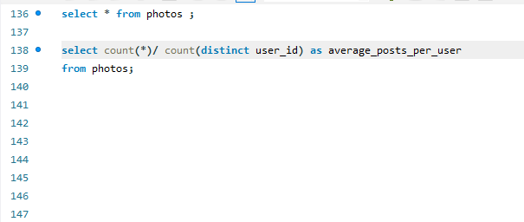

INSIGHTS
User Engagement :
Query input statement
Query Output
This query gives to calculate the average number of posts per user on Instagram so that investors can know if users are still active and posting on Instagram or if they are making fewer posts.

Slide 12
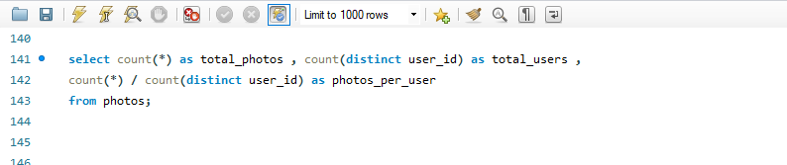
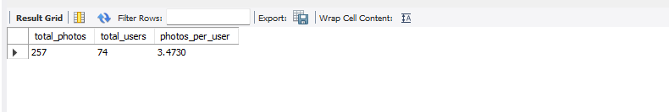
INSIGHTS
User Engagement :
Query input statement
Query Output
This query gives provide the total number of photos on Instagram divided by the number of users so that investors can know if users are still active and posting on Instagram or if they are making fewer posts.

Slide 13
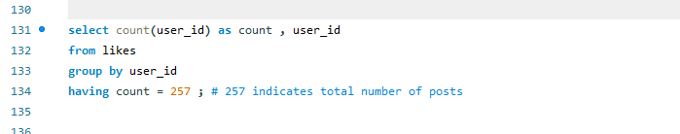
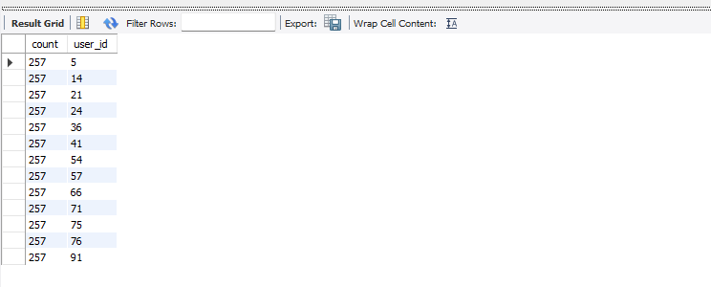
INSIGHTS
Bots & Fake accounts :
Query input statement
Query Output
This query gives list of user id’s who liked every posts on the platform. If the like count of a user is equal to the total number of posts on platform ,then the user can be treated as potential bot.

Slide 14
RESULT
By giving the five oldest users , the Instagram team can give most loyal user rewards
By finding the inactive user list the Instagram team can send promotional emails to them so that they can actively post something on the platform
By finding the most likes on the single photo and declaring as the winner in the contest can push the other users to upload new and creative posts so that they can get the more likes and can be the winner of the contest.
By finding the most used hashtags, the other companies can use these hashtags on their posts so that it can reach to the more users in Instagram.

Slide 15
By finding the days in which most users get registered can be helpful to the ad campaigns so that it can reach to the most users registered.
By calculating the average post per user on Instagram so that investor can know if users are still active and posting on Instagram or if they are making fewer posts.
By finding the users who have liked every post on Instagram can be helpful to find out potential bots that means a real user cannot like every post on Instagram.
In these way these queries can makes insights for the Instagram team.

Slide 16
THANK YOU
Parimi Venkata Surya Kiran
parimikiran2003@gmail.com

